Slide 1
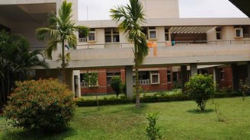


Hostel management system
Under the guidance of: Presented by:
Prof.Sushma M M.Tech…..MISTE Chandana R (21IS016)
Assitant Professor Monika B N (21IS047)
Dept. of ISE

Slide 2
Agenda
Introduction Objective Hardware and Software Requirements System Architecture Conclusion Future Work

Slide 3


intoduction
The Hostel Management System with Attendance Tracking and Facility Maintenance is a comprehensive database management system designed to streamline and enhance the administrative processes of a hostel. This mini project integrates key features such as attendance tracking, yearly room change details.
The system includes a user-friendly interface accessible to both hostel administrators and residents. The attendance tracking module allows administrators to efficiently monitor and manage the attendance of hostel residents.

Slide 4
objective
The aim of this project is to design and implement a comprehensive Hostel Management System (HMS) using PHP and MySQL, with the goal of automating and improving various hostel-related processes. The system aims to enhance efficiency, transparency, and user satisfaction in the management of hostel facilities within educational institutions.

Slide 5

“software requirements”
Hardware requirements
Multi Processor
RAM: 4 GB and above
Hard Disk: 1 TB and above
Reliable internet connection
Operating system- Any Web Server: Apache or Nginx PHP Version: 7.0 or higher Database: MySQL Any Web Browser Development Environment: XAMPP

Slide 6
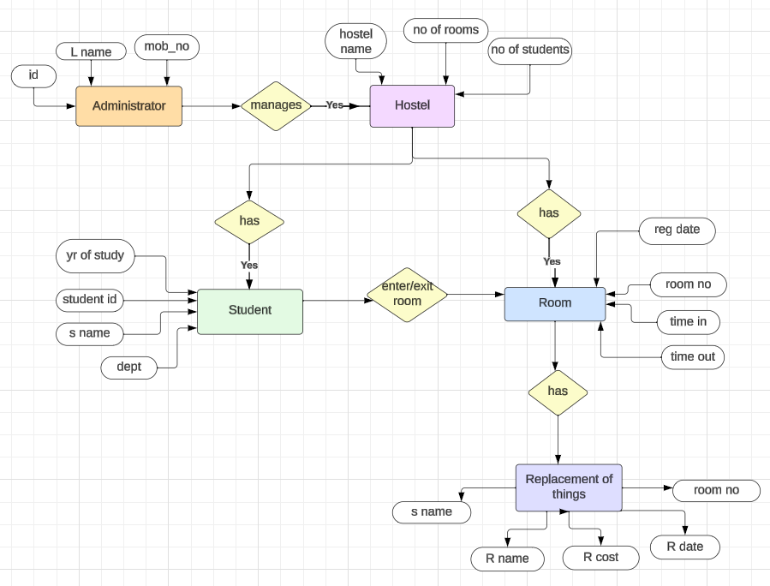
System architecture

Slide 7
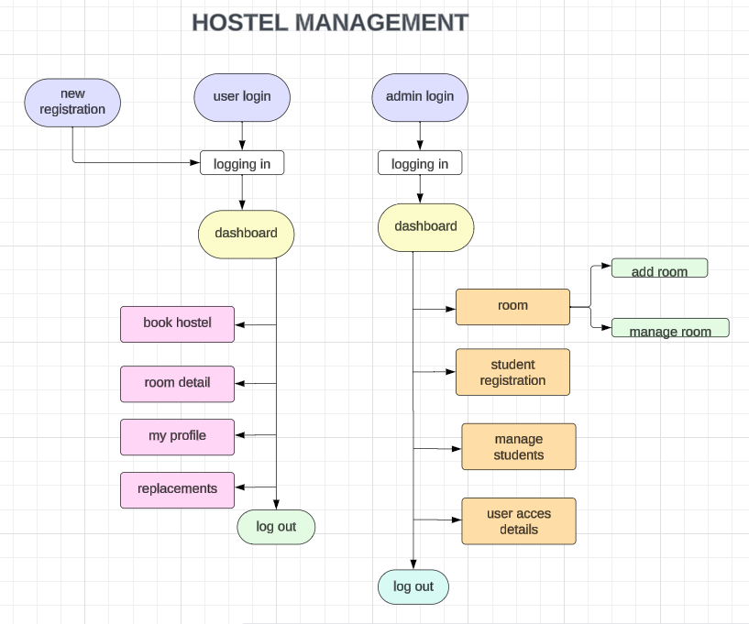
Flow chart of hostel management system

Slide 8
Conclusion:
The Hostel Management System developed using PHP and MySQL presents a comprehensive solution to streamline the management of hostel operations, catering to both students and administrators.
The implementation of this system addresses several key challenges faced in traditional hostel management, providing an efficient and user-friendly platform.
The system begins with a robust user authentication module, ensuring secure logins for students and administrators.

Slide 9
Future work
Explore integration with IoT devices for real-time monitoring of room conditions, security, and resource usage.
Develop a mobile application for both students and administrators to enhance accessibility and convenience.
Extend the system to include financial management features, such as fee collection, expense tracking, and budget forecasting.
Implement advanced security measures, including biometric authentication for users and encryption of sensitive data.
Design the system architecture to be easily scalable, accommodating an increasing number of users, rooms, and courses.

Slide 10
Thank you
Hostel management system

